Slide 1
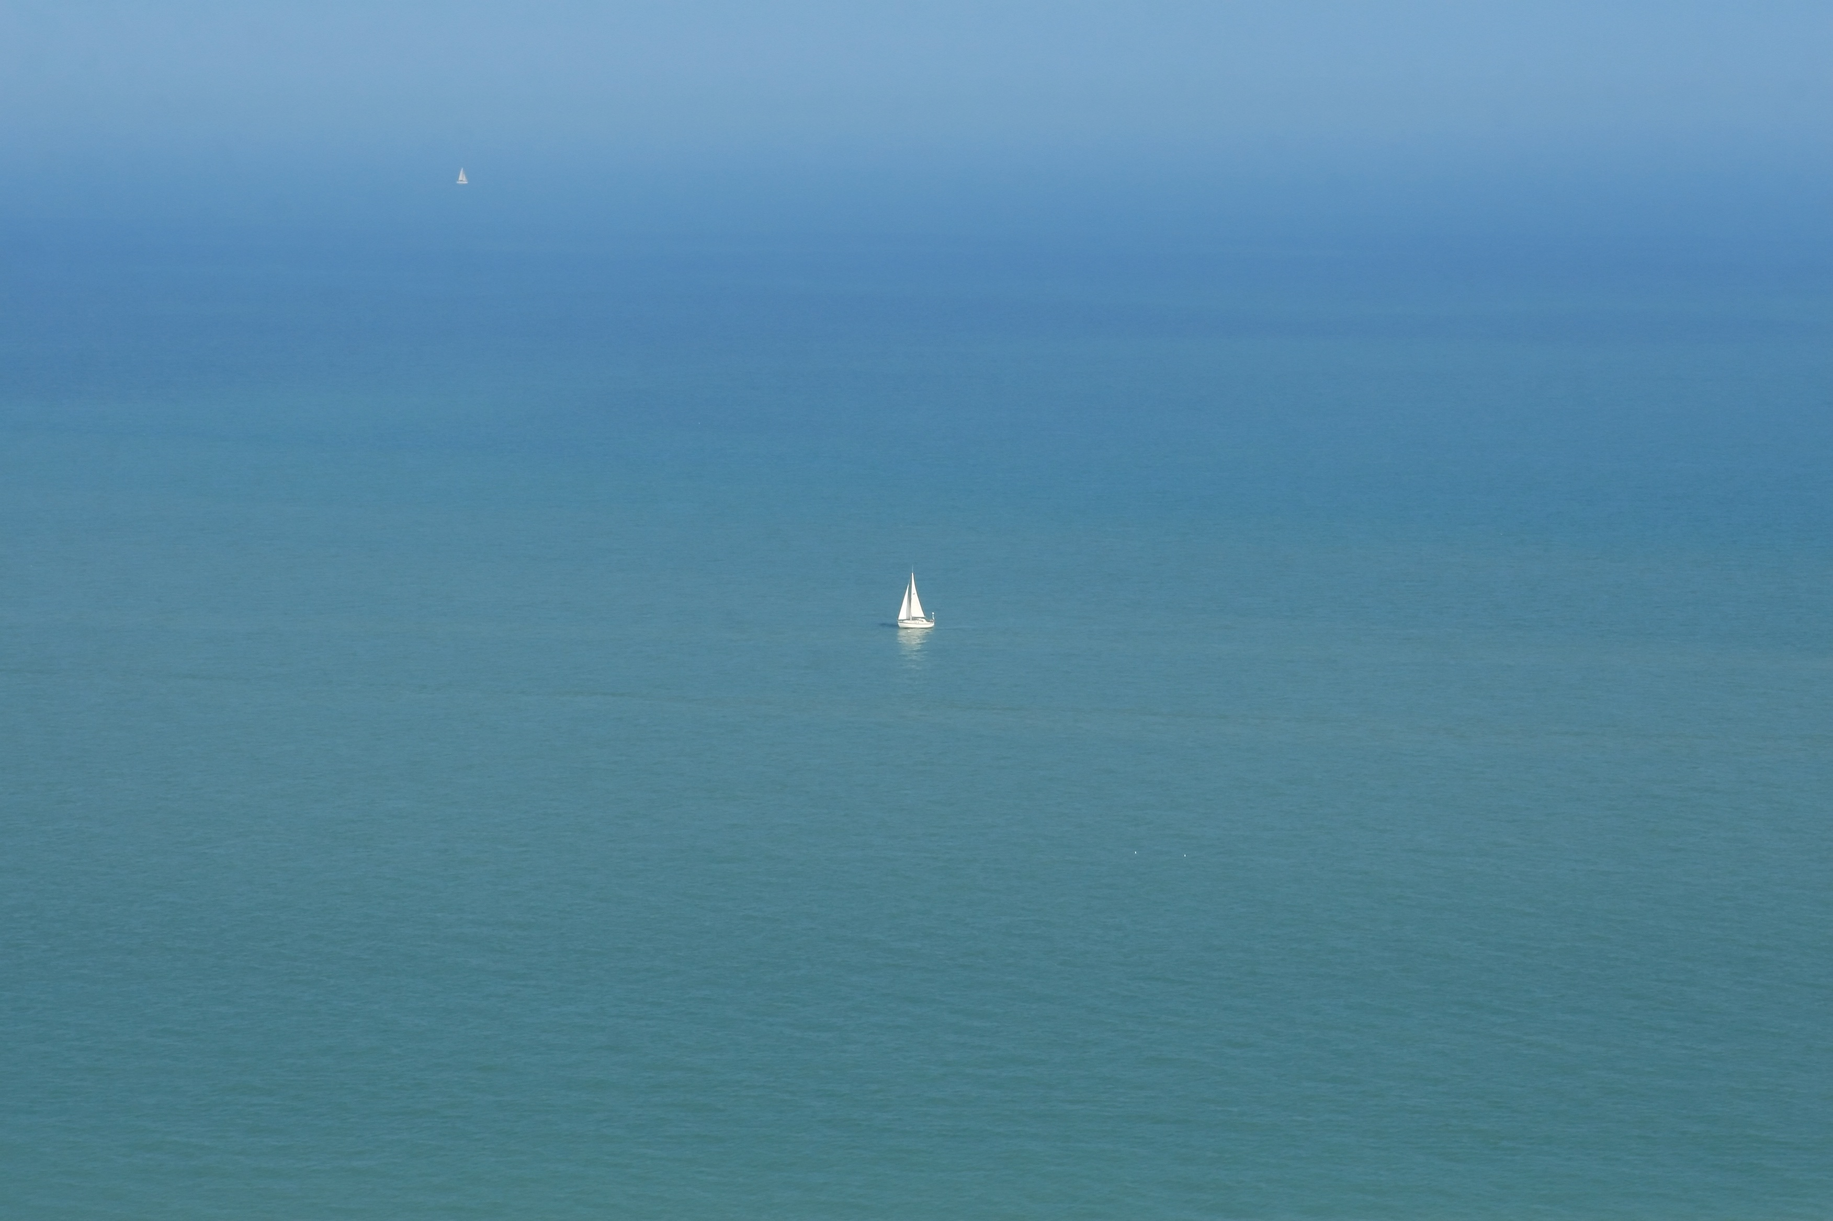
FLOATING POINT
3 141592653
A site about sailing and coding

Slide 2
FLOATING POINT
3 141592653
A site about sailing and coding

